Slide 1
DMC-CFA Workshop ARENA Hands-on Experience
Team members: Cheng Tan, Chenhao Xie,
Tong Geng, Ang Li (PI)
Notes:
Image: Abstract Data Visualization – Stock Photo

Slide 2
ARENA: Asynchronous Reconfigurable Accelerator Ring for the Next Generation HPC Clusters
Background
System architecture
Programming model
Evaluation
Tutorial

Slide 3
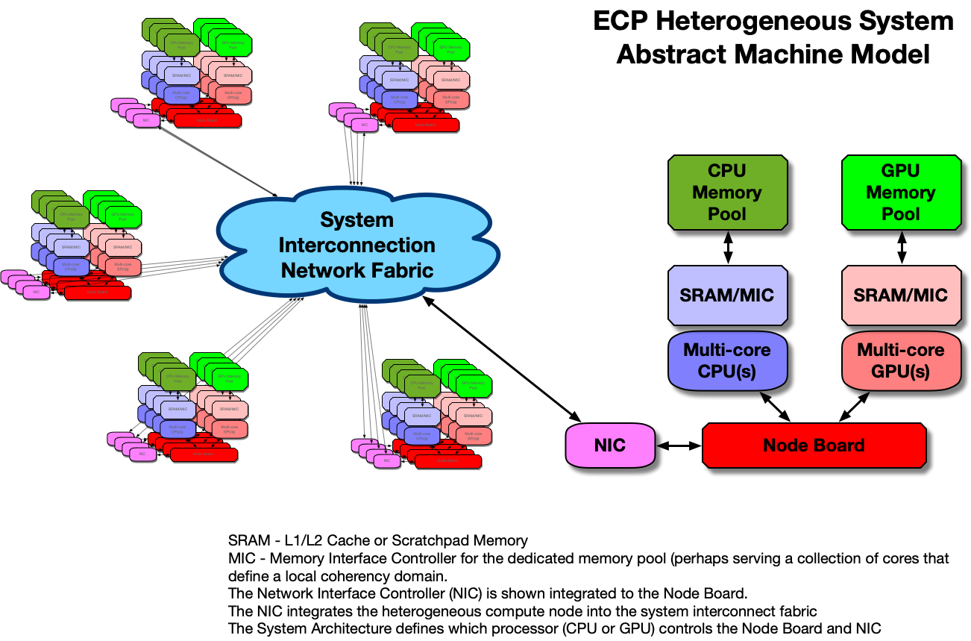
Background – Abstract Machine Model (AMM)

Slide 4
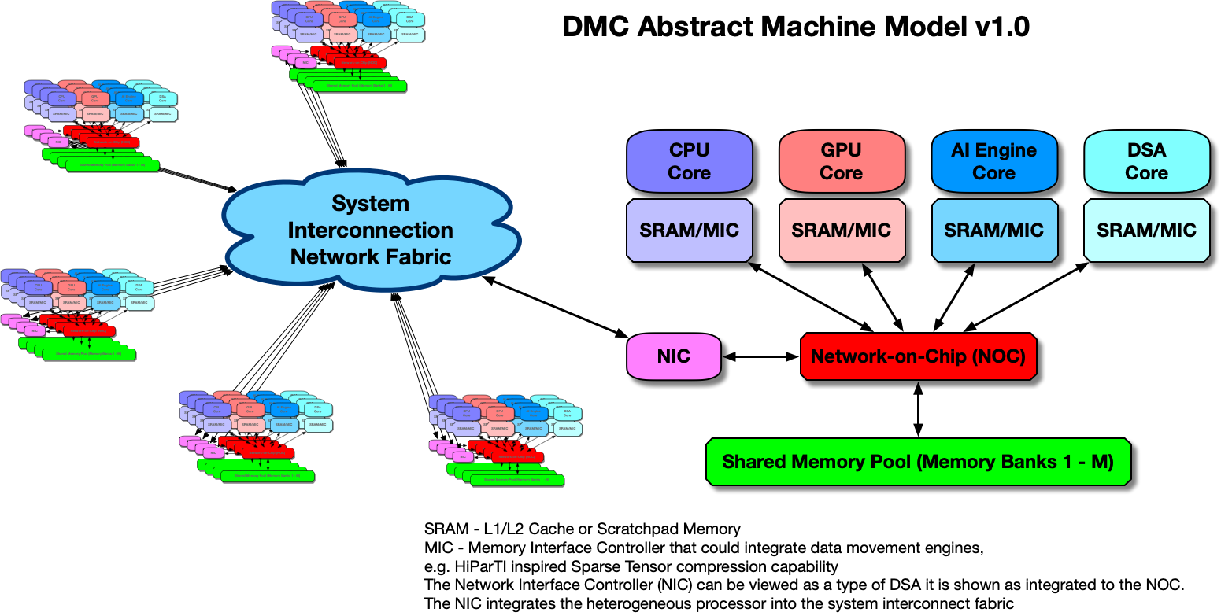
Background – Abstract Machine Model (AMM)
1. More heterogeneity
2. Shared memory
3. System-on-chip via NoC

Slide 5
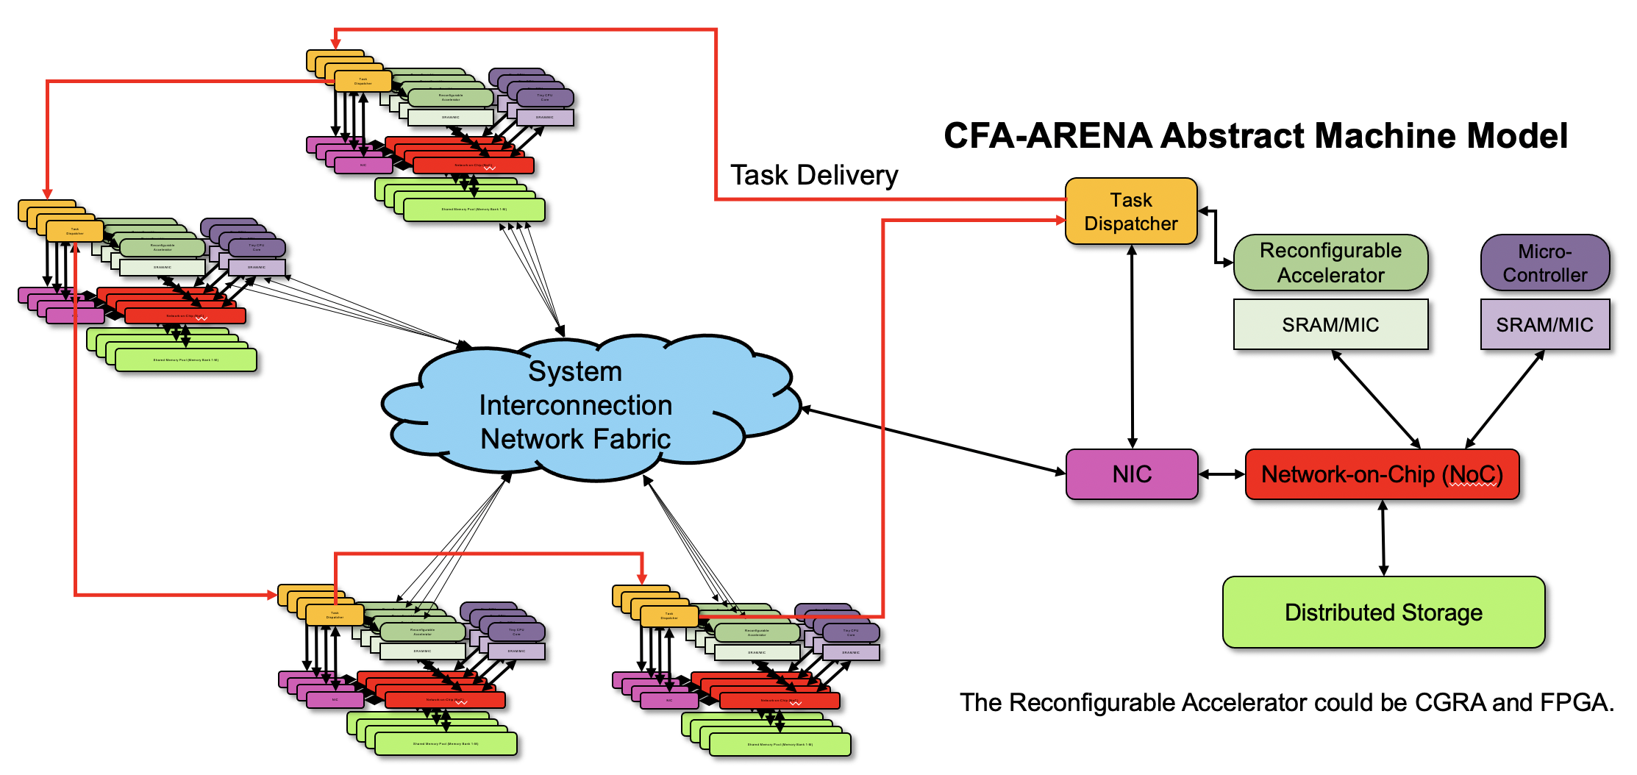
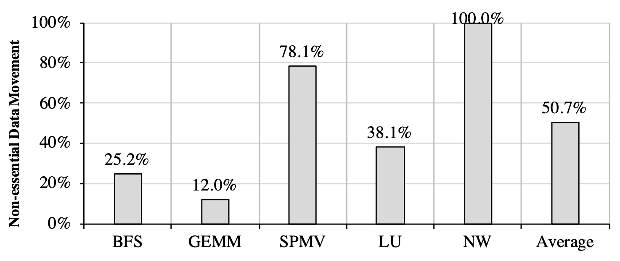
Background – Abstract Machine Model (AMM)
1. More heterogeneity
2. Shared memory
3. System-on-chip via NoC
1. Reconfigurability
2. Synchronous process-based vs. asynchronized task-based
3. Compute-flow architecture
Notes:
1. Conventional is synchronous process-based model vs. asynchronous task-based.

Slide 6
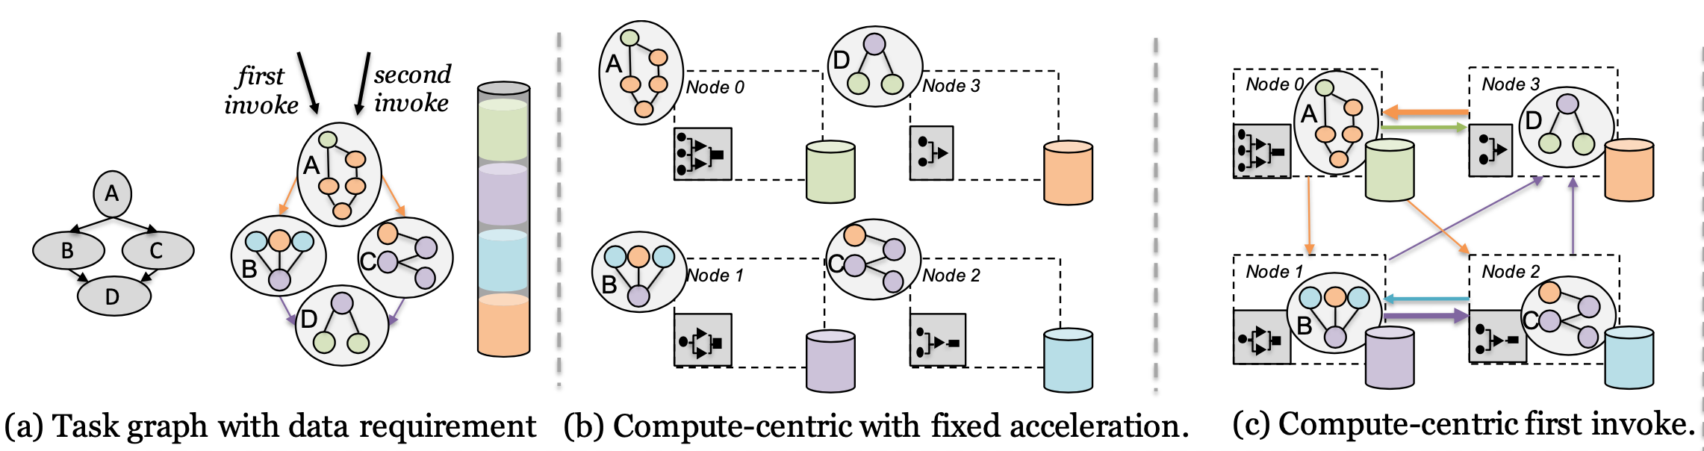
Background – Motivating Example
Conventional compute-centric vs. data-centric execution

Slide 7
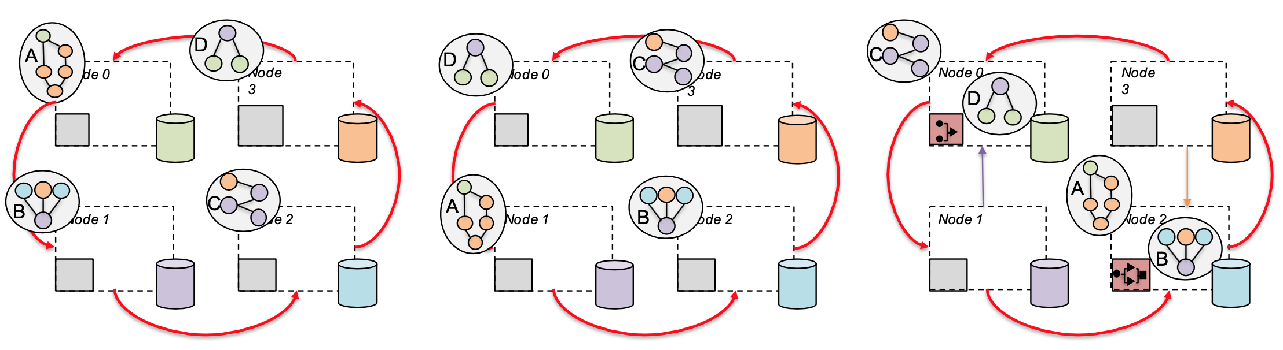
Background – Motivating Example
Conventional compute-centric vs. data-centric execution
Reducing non-essential data movement
(d) ARENA’s data-centric with dynamic reconfigurable acceleration

Slide 8
System Architecture
Overview
Micro-architecture of ARENA node
Software/hardware implementations

Slide 9
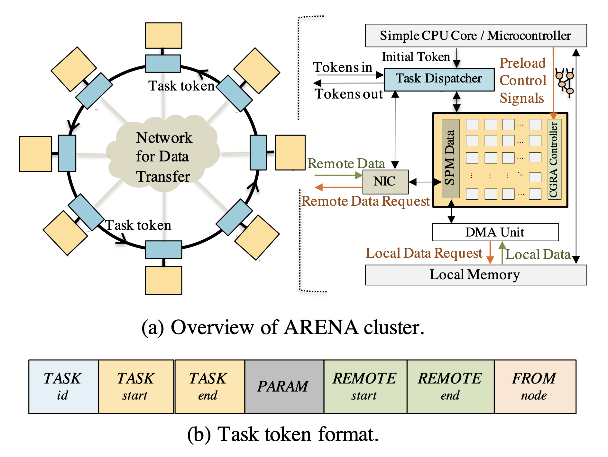
Overview of ARENA
Task token delivered in the ring
Task dispatcher
NIC
CGRA/FPGA or CPU

Slide 10
Overview of ARENA
Task token delivered in the ring
Task dispatcher
NIC
CGRA/FPGA or CPU

Slide 11
Overview of ARENA
Task token delivered in the ring
Task dispatcher
NIC
CGRA/FPGA or CPU

Slide 12
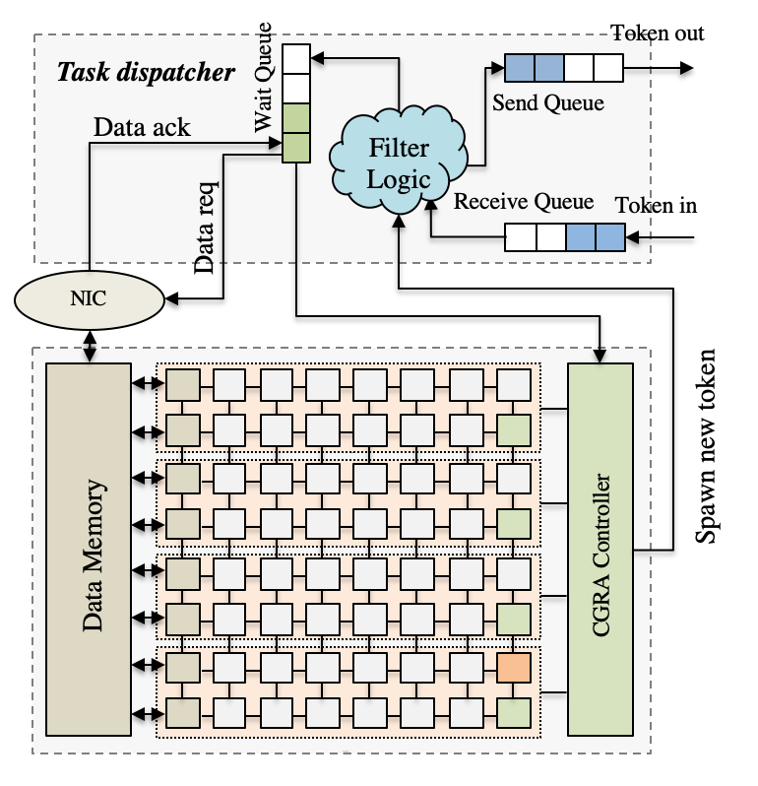
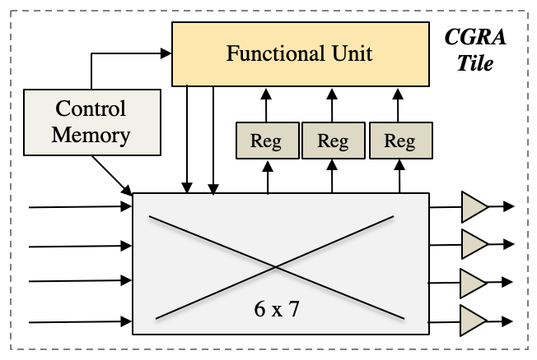
Micro-Architecture of ARENA Node
Task dispatcher
Receive Queue
Send Queue
Wait Queue
CGRA
CGRA Controller
Scratchpad Data Memory
8x8 Tiles

Slide 13
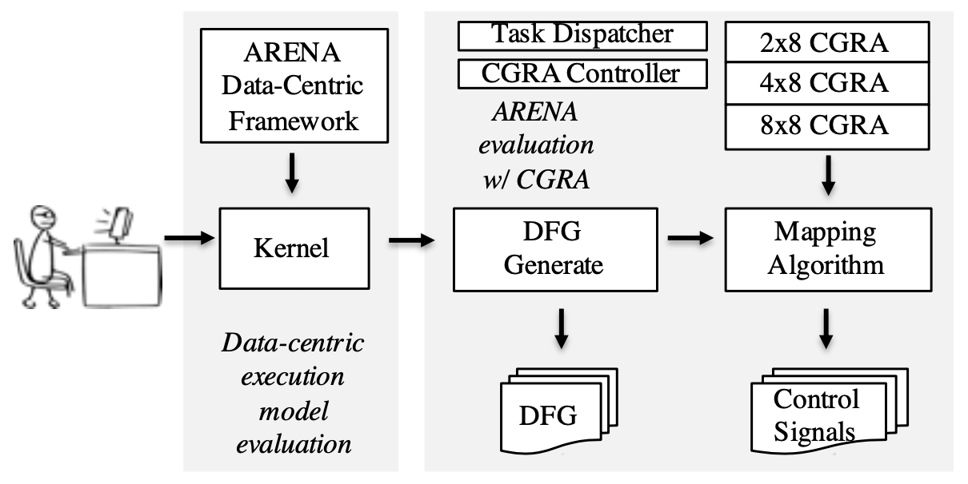
Software/Hardware Implementations
Software framework
Implemented using MPI
Mimic functionality of dispatcher
Evaluate execution model
Hardware implementation
CGRA support
RTL-based task dispatcher, CGRA, and CGRA controller

Slide 14
Software/Hardware Implementations
Software framework
Implemented using MPI
Mimic functionality of dispatcher
Evaluate execution model
Hardware implementation
CGRA support
RTL-based task dispatcher, CGRA, and CGRA controller

Slide 15
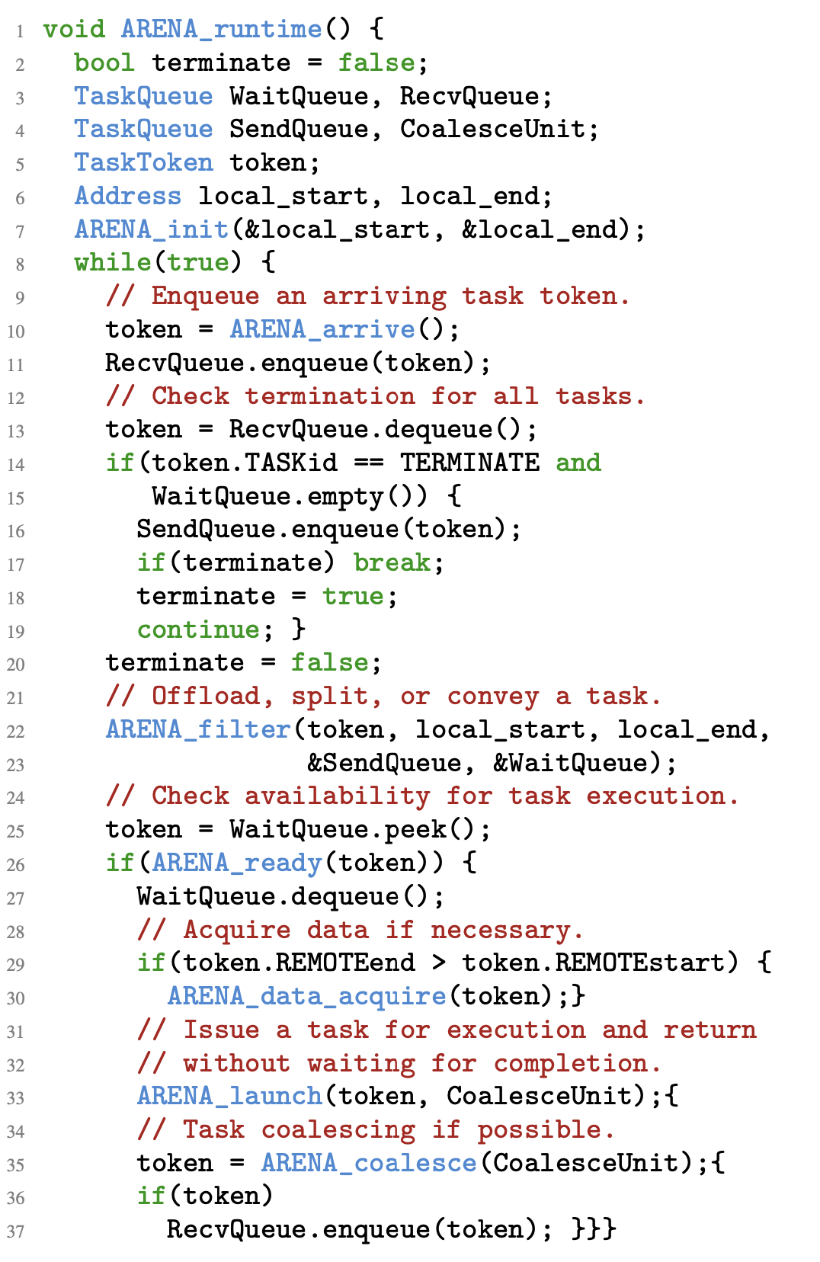
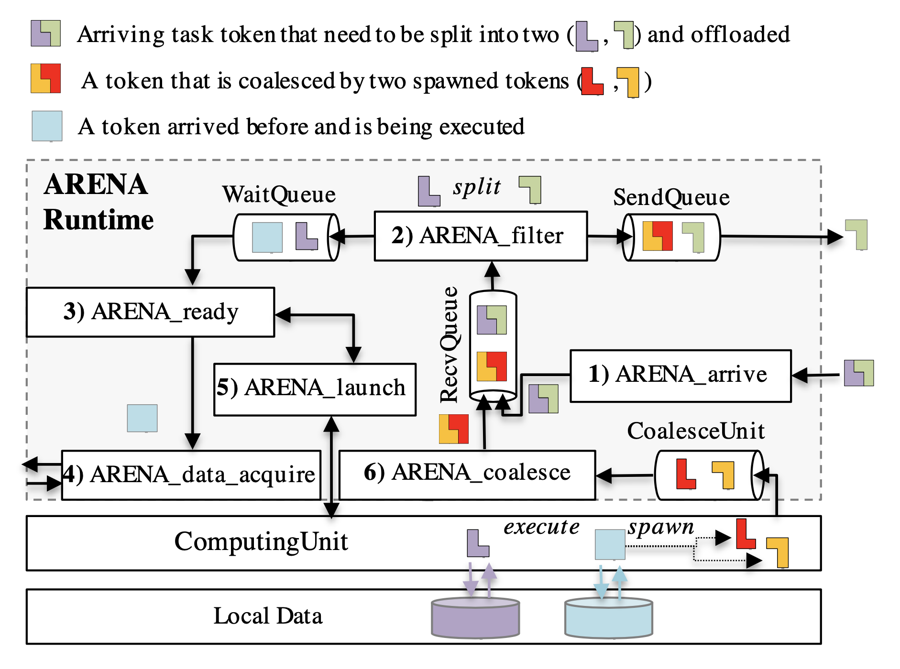
Programming Model
ARENA runtime

Slide 16
Programming Model
ARENA runtime

Slide 17
Programming Model
ARENA runtime

Slide 18
Programming Model
ARENA runtime

Slide 19
Programming Model
ARENA runtime

Slide 20
Programming Model
ARENA runtime

Slide 21
Programming Model
ARENA runtime

Slide 22
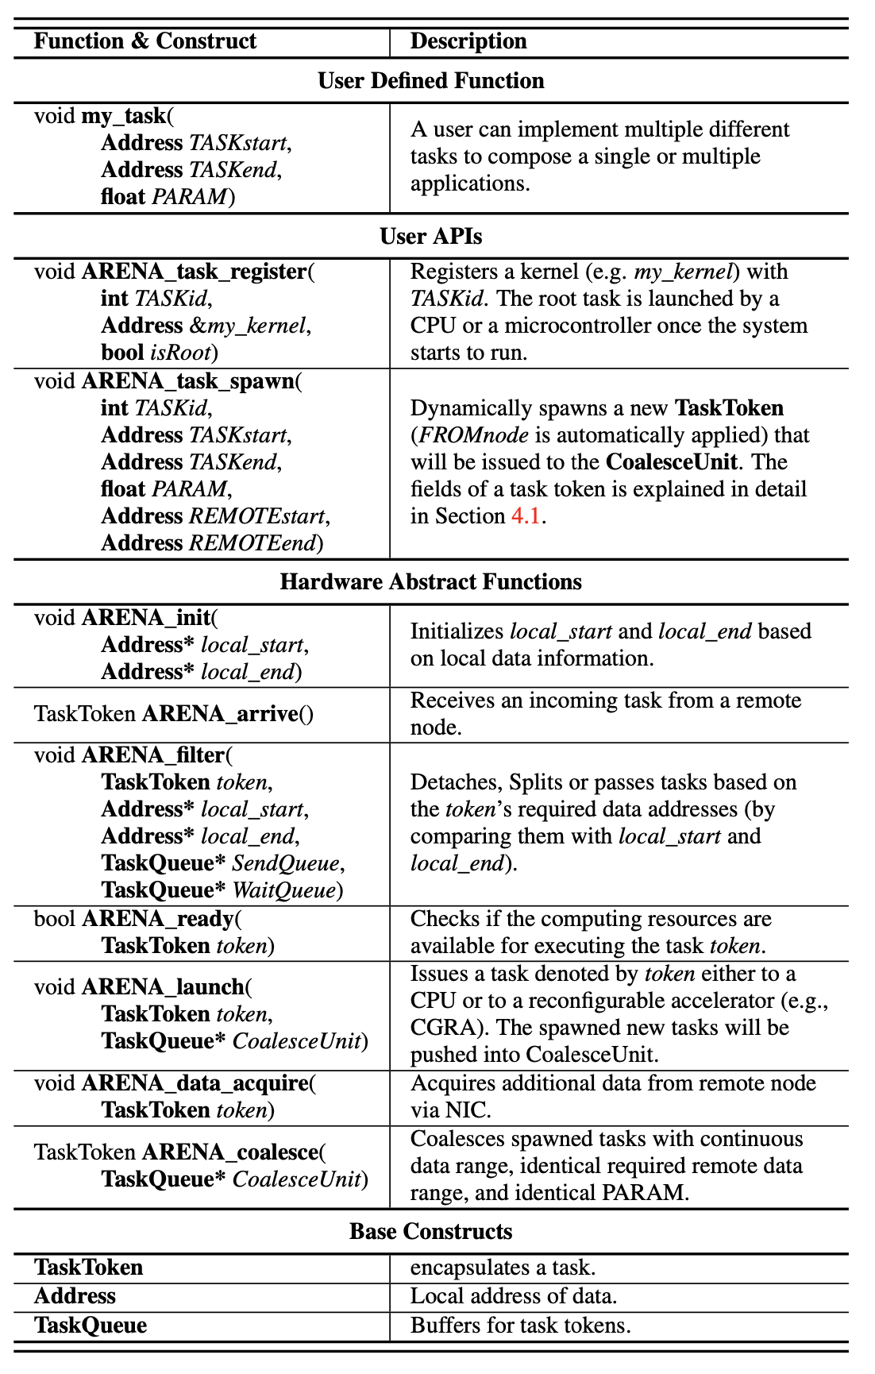
Programming Model
ARENA runtime
ARENA programming interfaces
User-defined functions/tasks
User APIs
Hardware abstract functions
Base constructs
ARENA APIs

Slide 23
Programming Model
ARENA runtime
ARENA programming interfaces
User-defined functions/tasks
User APIs
Hardware abstract functions
Base constructs
ARENA APIs

Slide 24
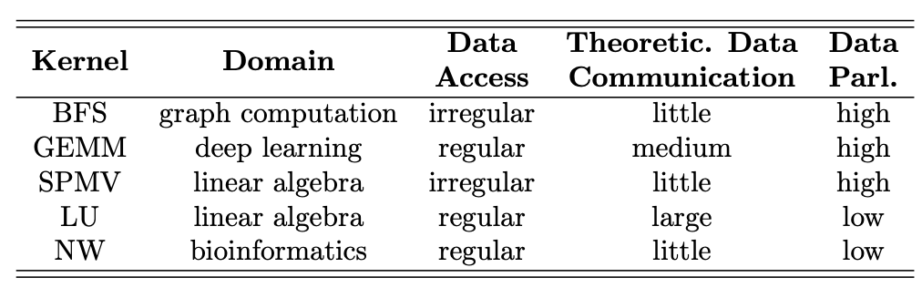
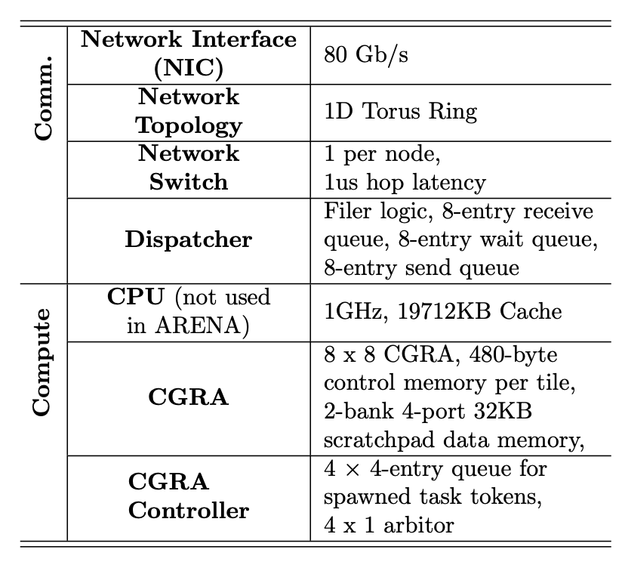
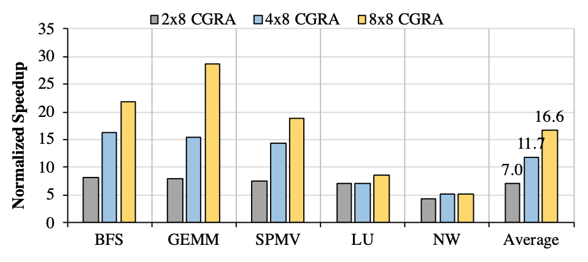
Evaluation
Representative HPC kernels
Simulation environment
SST + RTL
ARENA’s Data-centric execution model
Asynchronous task execution
Reduced data communication
CGRA speedup
2x8 tiles
4x8 tiles
8x8 tiles
Simulation environment

Slide 25
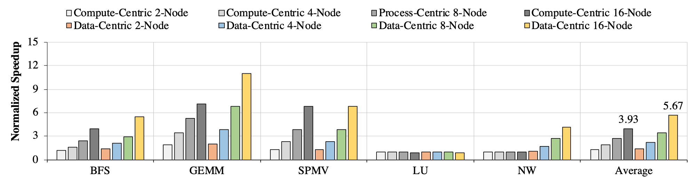
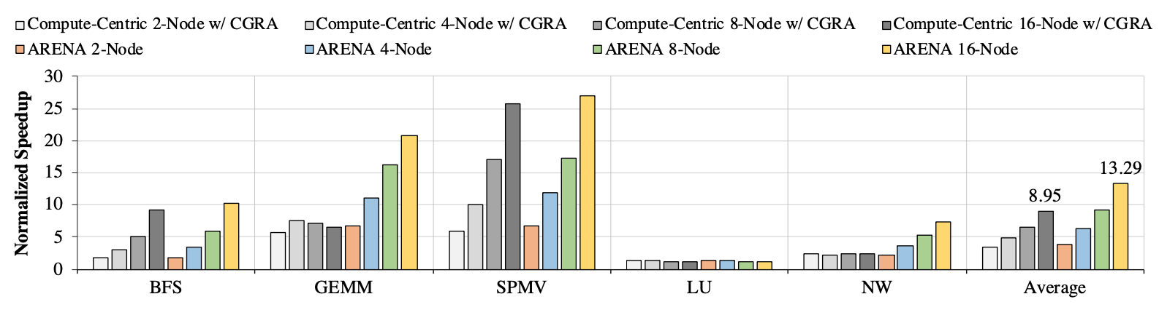
Evaluation

Slide 26
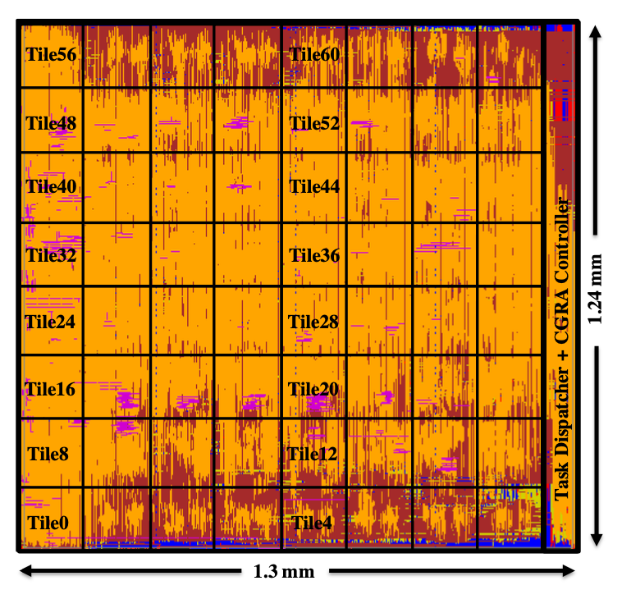
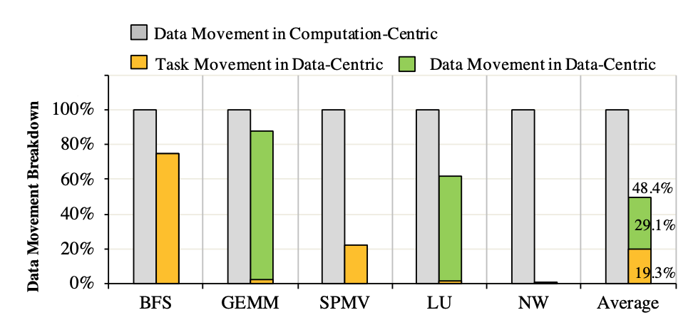
Evaluation
Representative HPC kernels
Simulation environment
ARENA’s Data-centric execution model
CGRA speedup
Reduced data communication
ARENA layout (w/o data memory)
Synthesized by OpenCGRA (SODA^2 + CFA)
https://github.com/pnnl/OpenCGRA

Slide 27
Take-aways
Programming Model Comparison
Cilk
Fork-join idiom requires synchronization
No data locality awareness
Centralized work stealer
MapReduce
Strict execution model
No data locality awareness
MPI
Conventional two-sided communication
Requires synchronization
OpenSHMEM
Partitioned Global Address Space (PGAS)
Implicit massive data movement under the hood

Slide 28
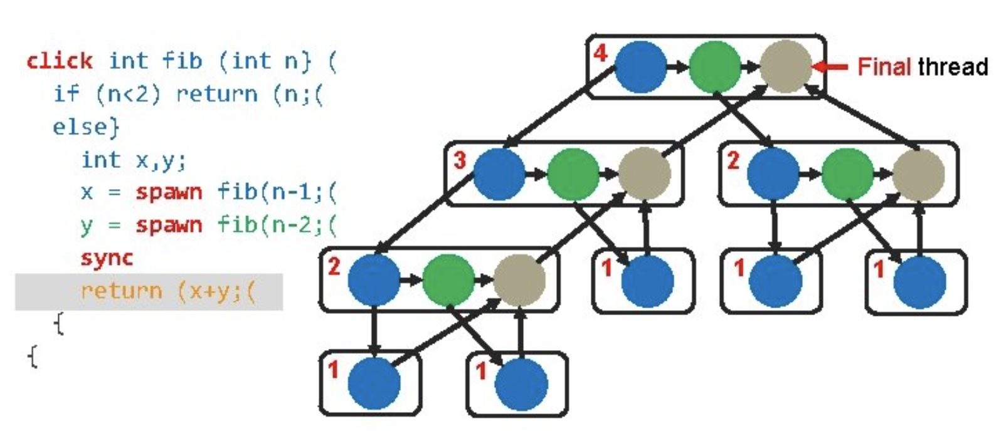
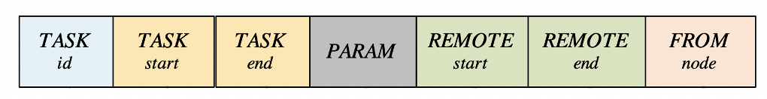
Take-aways
Programming Model Comparison
Cilk
Fork-join idiom requires synchronization
No data locality awareness
Centralized work stealer
MapReduce
Strict execution model
No data locality awareness
MPI
Conventional two-sided communication
Requires synchronization
OpenSHMEM
Partitioned Global Address Space (PGAS)
Implicit massive data movement under the hood
synch point in Cilk
Data locality awareness in ARENA

Slide 29
Take-aways
Programming Model Comparison
Cilk
Fork-join idiom requires synchronization
No data locality awareness
Centralized work stealer
MapReduce
Strict execution model
No data locality awareness
MPI
Conventional two-sided communication
Requires synchronization
OpenSHMEM
Partitioned Global Address Space (PGAS)
Implicit massive data movement under the hood
synch point in Cilk
Data locality awareness in ARENA

Slide 30
Take-aways
Programming Model Comparison
Cilk
Fork-join idiom requires synchronization
No data locality awareness
Centralized work stealer
MapReduce
Strict execution model
No data locality awareness
MPI
Conventional two-sided communication
Requires synchronization
OpenSHMEM
Partitioned Global Address Space (PGAS)
Implicit massive data movement under the hood
Suitable Applications
Graph Applications
Sparsity/workload imbalance
Monte-Carlo Markov algorithm
Variable chain length
Molecular Dynamics (MD)/Nbody
Irregular communication
Workload imbalance
Reinforcement Learning
Variable rollout length

Slide 31
Tutorial
HelloWorld
SSSP
GEMM
GCN (dense/HiCOO)

Slide 32
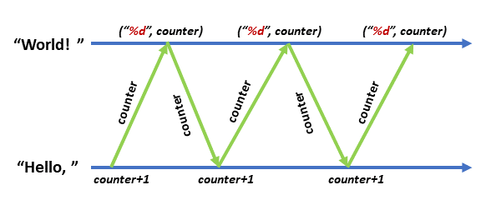
Tutorial – HelloWorld
Classic ping-pang problem
What we want to learn:
Data-centric execution: The data range indicated by a token should match the data range of the specific machine that captures/executes the token.
A value can be carried by the task token: counter is passed between machines using the ‘PARAM’ indicated by the token.
Data range: 20 ~ 30
Node 0
Token (0~5)
Token (21~25)
Data range: 0 ~ 10
Node 1

Slide 33
Tutorial – SSSP
Single Source Shortest Path
Adjacency matrix
What we want to learn:
Data-centric execution: A graph node is executed by a specific machine where the node resides.
A value can be carried by the task token: ‘hops’ is passed between machines using the ‘PARAM’ indicated by the token.
Nodes range: 0 ~ 1
Machine 0
node0
0
∞
0
∞
node1
Nodes range: 1 ~ 2
Machine 1
node2
Nodes range: 2 ~ 3
Machine 2
node3
Adjacency Matrix:
`∞` indicates an edge,
`0` indicates no edge
Nodes range: 3 ~ 4
Machine 3

Slide 34
Tutorial – GEMM
GEMM: ⍺ x A x B + β x C
A, B’, C are equally distributed
What we want to learn:
Essential data movement: Transposed matrix B’s rows.
Row range: 0 ~ 1
Machine 0: Row(A1) x Row(B1)
X
Matrix A
Transposed matrix B
(pipelined delivered on ring)

Slide 35
Tutorial – GEMM
GEMM: ⍺ x A x B + β x C
A, B’, C are equally distributed
What we want to learn:
Essential data movement: Transposed matrix B’s rows.
Row range: 0 ~ 1
Machine 0: Row(A1) x Row(B1)
X
Row range: 1 ~ 2
Machine 1: Row(A2) x Row(B1)
Matrix A
Transposed matrix B
(pipelined delivered on ring)

Slide 36
Other examples -- GCN
Graph Convolutional Network
Two-layer GCN with CORA dataset
Main computation: A x X x W
Dense/HiCOO (HiParTi + CFA)
Power grid cascading failure prediction (HollonicML + CFA)
Try to include more built-in kernels to ease the programming effort

Slide 38
ARENA: Asynchronous Reconfigurable Accelerator Ring for the Next Generation HPC Clusters
Cheng Tan, Chenhao Xie, Tong Geng, Andres Marquez, Antonino Tumeo, Kevin Barker, Ang Li
Notes:
NOTE: This file must print at 200% SCALE to achieve a final print size of 60” wide x 42” tall.
• Contact Digital Duplicating (375-2969, http://digitalduplicating.pnl.gov) to order poster printing and finishing services for your completed poster design.
• Remember to have your poster cleared for public display/distribution through the Information Release system (https://informationrelease.pnl.gov).

Slide 39
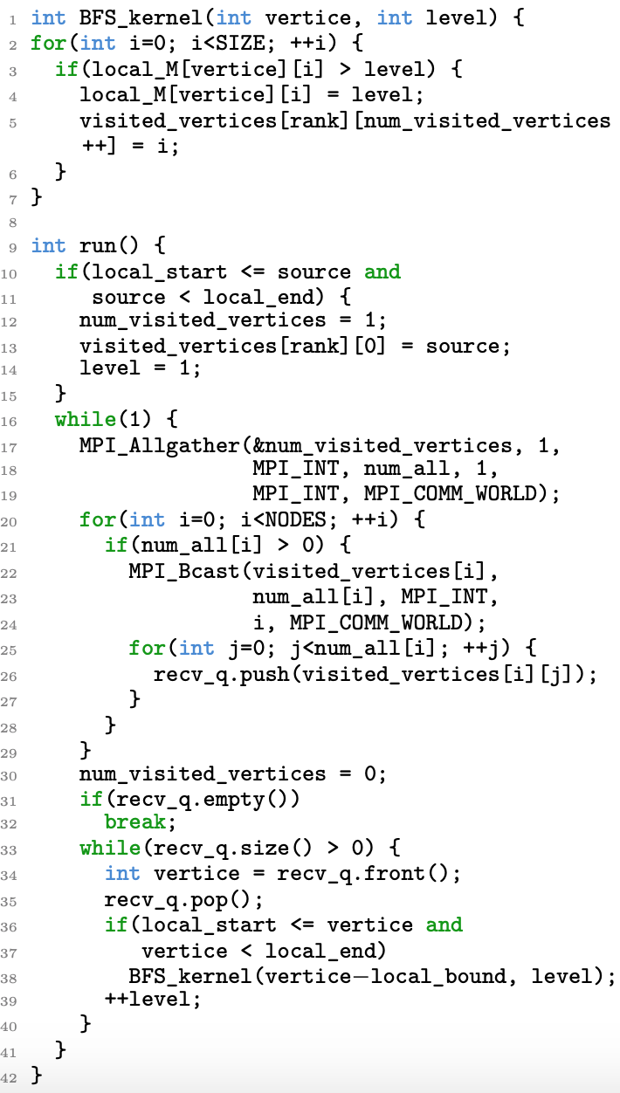
Tutorial – BFS Kernel
Single source shortest path
Conventional compute-centric model
Implemented using MPI
Non-essential data communication
Synchronization overhead

Slide 40
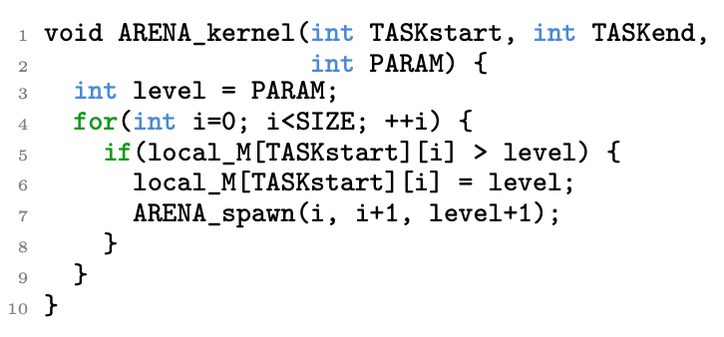
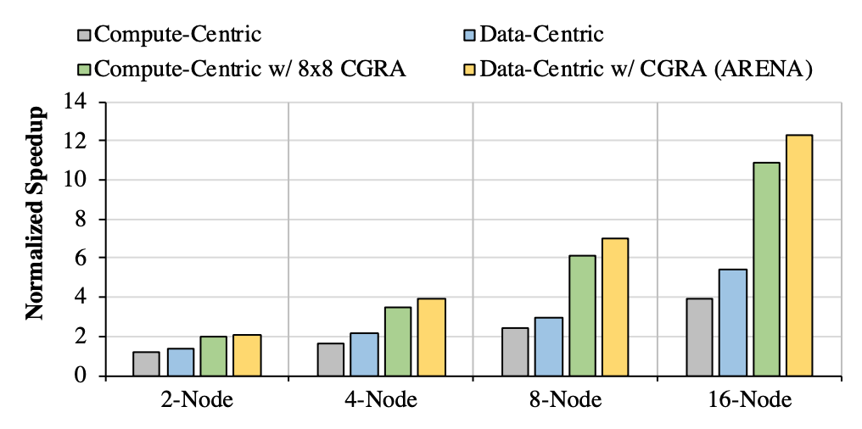
Case Study – BFS Kernel
Single source shortest path
Conventional compute-centric model
Implemented using MPI
Non-essential data communication
Synchronization overhead
ARENA’s Data-centric execution model
Asynchronous task execution
Reduced data communication

